Slide 1


Exploratory Data Analysis on Facebook
By Kameswara Sarma

Slide 2
Agenda
Problem Statement
Data Collection
Data Visualization
Analysis of Dataset
Summary

Slide 3
Problem Statement
Analyze important parameters for using social media, FACEBOOK to derive insights on various trends such as age group of users, friend counts, platform and how these parameters are interlinked.
Dataset Information:
The data set has 15 types of attributes
There are certain differences in the way Facebook is used by different age group and gender
This will help the company to utilize the patterns in the next set of iteration development and improving their application and user experience

Slide 4
Dataset information
Column Name | Description
userid | A numeric value uniquely identifying the user
age | Age of the user in years
dob_year | Year part of the user's date of birth
gender | Gender of the user
tenure | Number of days since the user has been on FB
friend_count | Number of friends the user has
friendships_initiated | Number of friendships initiated by the user
likes | Total number of posts liked by the user
likes_received | Total Number of likes received by user's posts
mobile_likes | Number of posts liked by the user through mobile app
mobile_likes_received | Number of likes received by user through mobile app
www_likes | Number of posts liked by the user through web
www_likes_received | Number of likes received by user through web

Slide 5
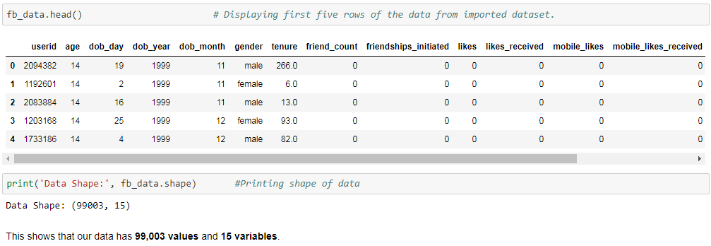
Data Acquisition

Slide 6
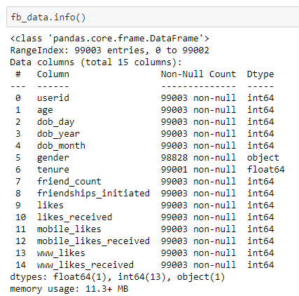
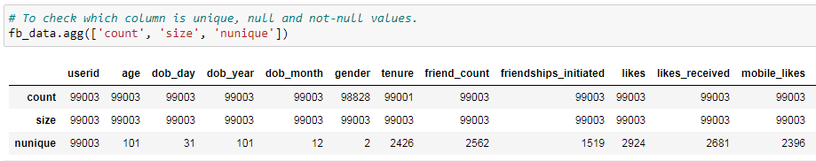
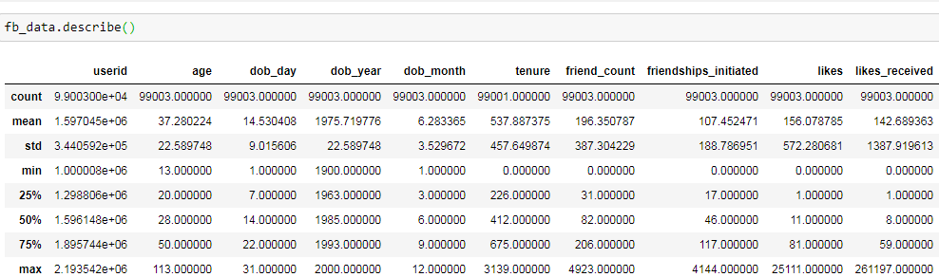

Insights on Data
Data is clean. There are no negative values
There are only two genders in our dataset
Mean is approximately equal to median which is at 50th percentile for first 6 columns (till tenure) and is considerably more for remaining 9 columns
We also see that there is significant difference between 75th percentile and max value for columns like, like_received, mobile_likes, mobile_likes_received, www_likes, www_likes_received
Mimimum age of facebook user is 13 years and maximum is 113 years and average age of facebook users is 37

Slide 7
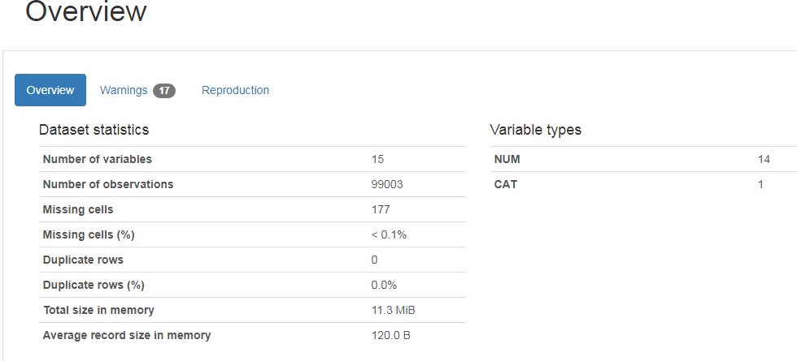
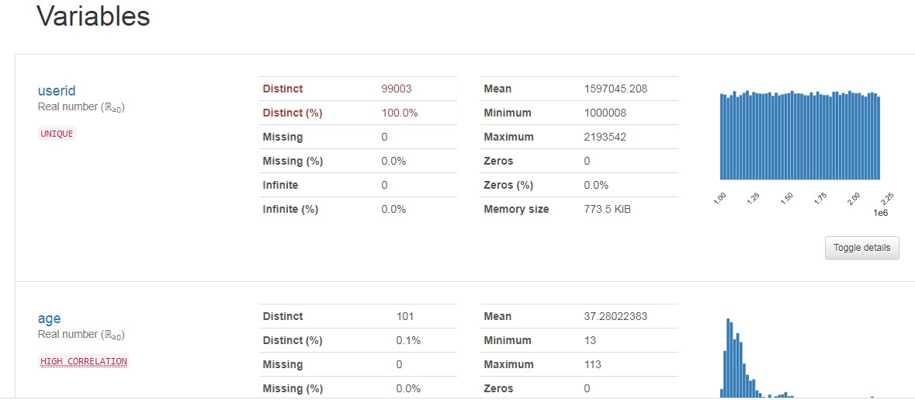
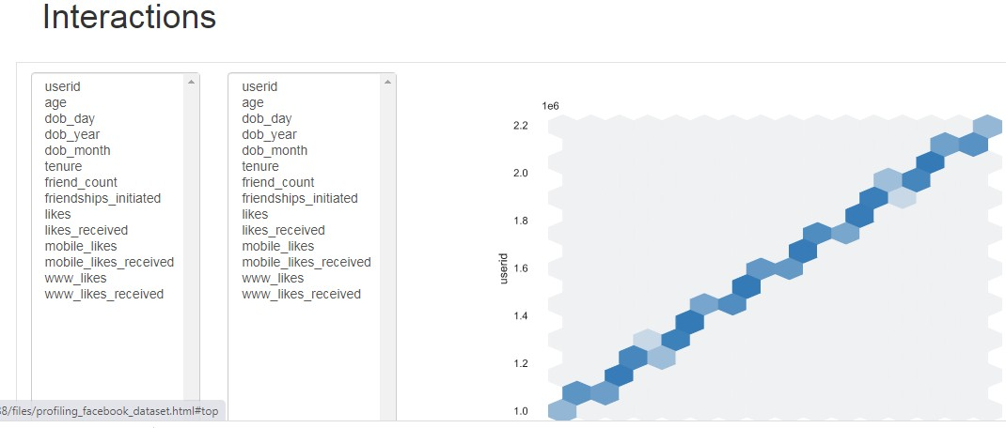
Pandas Profiling
Observations from Pandas Profiling before Data Processing
Dataset info:
Number of variables: 15 Number of observations: 99003 Missing cells: 177 (0.1%)
Variables types:
Numeric = 14
Categorical = 1
www_likes has 60999 (67%) zero values.
age is highly correlated with dob_year.
mobile_likes_received and www_likes_received are highly correlated with likes_received.
likes_received, mobile_likes_received and www_likes_received
are highly skewed with skewness of 112.0745, 107.5312
and 126.2573 respectively.
The distribution is positive (right) skewed as the mean
(142.689363) is to the right of the median
(8) for likes_received.
mobile_likes_received and www_likes_received are also positive (right) skewed for same reason .
Gender has data divided into 2 distinct values.
All the remaining columns can be studied in the same way.

Slide 8
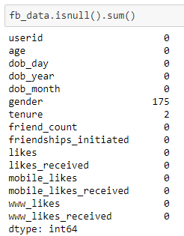
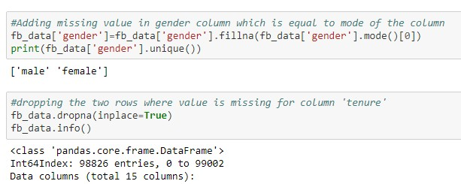

Handling Missing data
We have replaced null value of column gender by mode of the column
Additionally we have removed two rows where tenure value was missing as it was not having any impact on our dataset.
Similarly we have also remove column of users' day and month of birth as it will not fetch any analysis.
Now are data set has total of 99001 rows and 13 columns
We saw that 0.18% of entries are missing for gender and 0.002% of rows doesn't have tenure

Slide 9
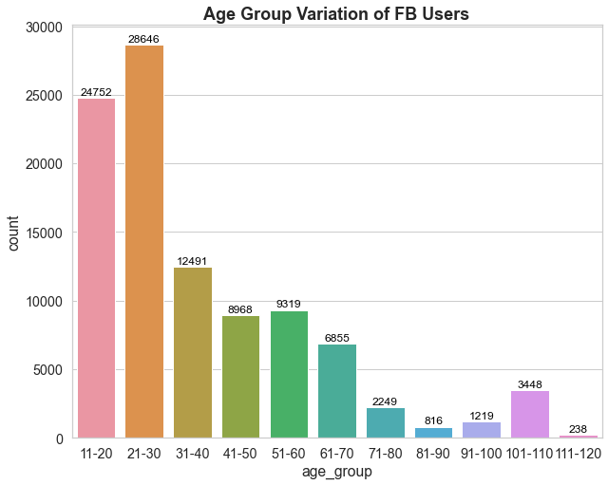
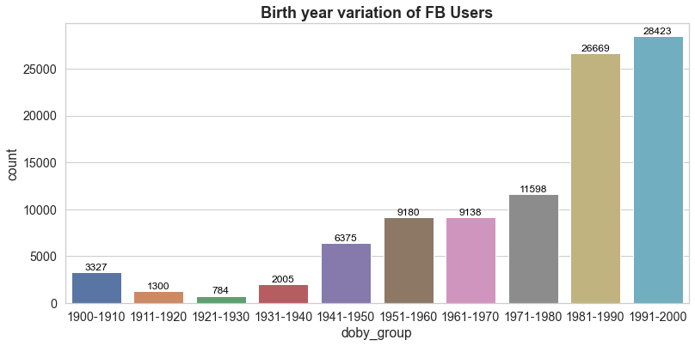
Data grouping on Age and birth year
People of age group 11-30 are the heaviest users of Facebook and then usage gradually declines
One thing to note is that sudden rise of users in age group 110-110 which can be linked to people who were born in 1990-1910
Facebook users count increases gradually for people born in year 1921 and onwards
Maximum users given in our dataset are born between 1981-2000, however we see more number of users in year range 1900-1910 compared to 1911

Slide 10
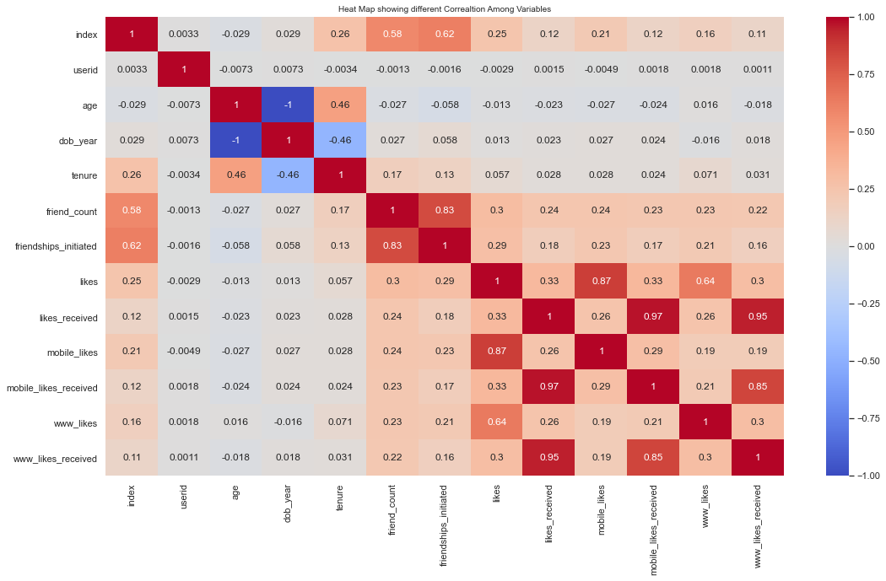

Correlation Matrix
Most of the likes received are mobile_likes_received (postively correlated)
Most of the likes given are also through mobile_likes (positively correlated)
'dob_year' is negatively correlated with 'age' and 'tenure' also 'age' & 'tenure' strongly correlated.
The correlation among variables (likes' & 'mobile_likes', 'likes' & 'www_likes', 'likes_received' & 'mobile_likes_received', 'likes_received' & 'www_likes_received', 'www_likes_received' & 'mobile_likes_received', tenure and 'friend_count' & 'friendships_initiated') is so strong that it can indicate a situation of multicollinearity.

Slide 11
Exploratory Data Analysis
By Kameswara Sarma

Slide 12
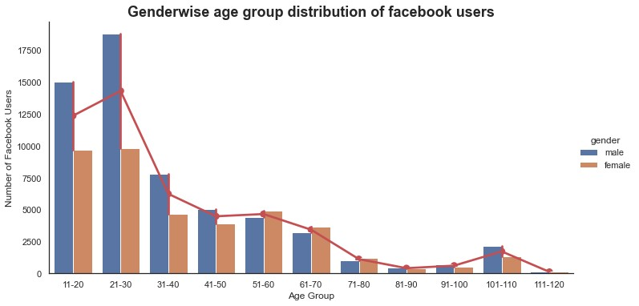
Gender and age group analysis
This shows that males between age of 11 to 30 years are twice more than males of age group 31 onwards.
The spike in males and females of age group 101 to 110 could be that these users have provided default date as 1900 year while setting up the Facebook account so that age can be unknown/ignored. Or these could be fake profiles
Facebook used by Male is higher than Female user between 11 to 50 year age but after 51 age onwards female usage is gradually increased compared to males.
Possible reason for less females on Facebook :
Privacy: a lot of women are worried about their privacy online as their pictures, profiles etc. have been misused.
Rural penetration: While the Internet and smartphones have reached tier 2,3 cities and villages, women still don't get their hands onto smartphones and internet as easily as men do.

Slide 13
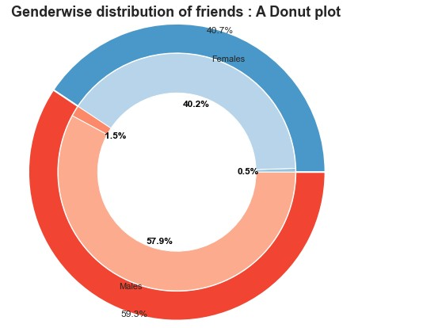




Gender wise friends analysis
Men 59.3%
Women 40.7%
There are only 0.5% females who doesn’t have friends on Facebook.
Males are heavy users of Facebook but many of them don’t have friends in comparison to females
This shows that females are more interested in building their social network and stay connected

Slide 14
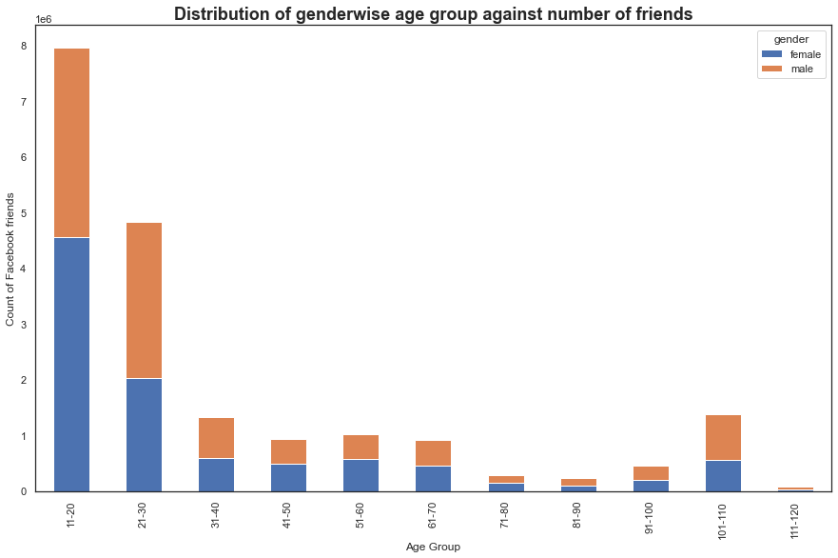

Age group friends analysis
This shows that users between age of 11 to 30 years have maximum number of friends when compared to users of other age group. Youngster tend to have bigger friend circle because of their school/college friends.
Trend starts declining for subsequent age group but we see friends count for age group 101 to 110 is almost twice of age group 71-90. Here we see that males have more friends than females
Generally, females use social networking sites to make connections and stay in touch with family or friends. Men, by contrast, use social media to gather the information they need to build influence.

Slide 15
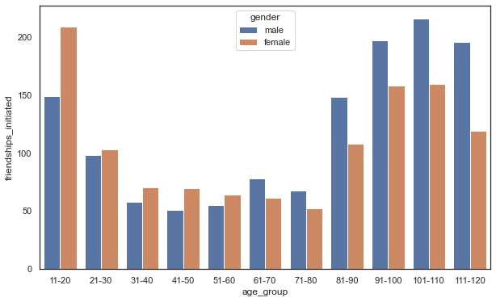
Age group initiated friends analysis
As seen above, females up to 60 years of age initiates more friend request compared to males of same age. This strengthens the point that females use social media more to stay connected with families and friends compared to men.
Yet again we see sudden rise in males of age group 91-110 years, in initiating friend requests. These people have mentioned their birth year between 1900-1920. This shows that people haven't entered all details correctly while creating account on Facebook.
Additionally, males with incorrect date of birth are the ones who have initiated maximum number of friend requests

Slide 16
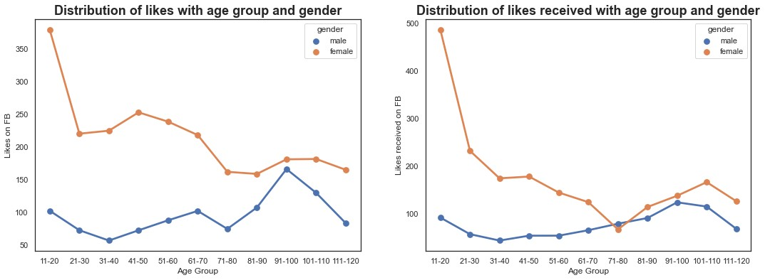
Highest likes received -Age group
For both likes and likes_received females outnumber males by significant value.
Additionally likes received by males upto age 80 are less than 100.
Females are more active on social media and show their support by liking each others' posts. Also females tend to post more pictures to have better impressions when compared to males thus fetching more likes.

Slide 17
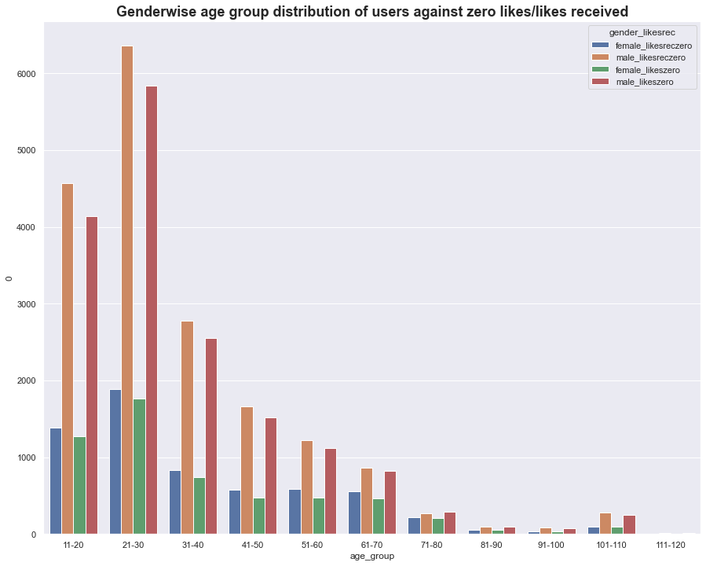
Highest likes received – Gender wise
We see that male population who doesn't have any likes is higher than females in every age group
A huge spike is noticed for zero likes/likes received in males of age group 21-30. This could be that this age group has more male users who have recently join Facebook and haven't posted much content whereas on the other hand females joined recently but started posting more content and hence got more likes.

Slide 18
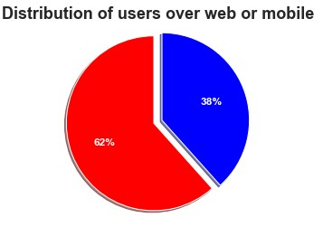


Platform wise user – web or mobile ?
The possible reason for using Facebook app over mobile :
With increasing demand of smart phone, it is convenient for users to use Facebook over app as mobiles are much more handy compared to laptops.
Apps can send push messages that keep users engaged with Facebook.
App icon is visible when a user explores their phone, keeping awareness high.
App can retain user data, enabling one-click checkouts and minimizing load times.

Slide 19
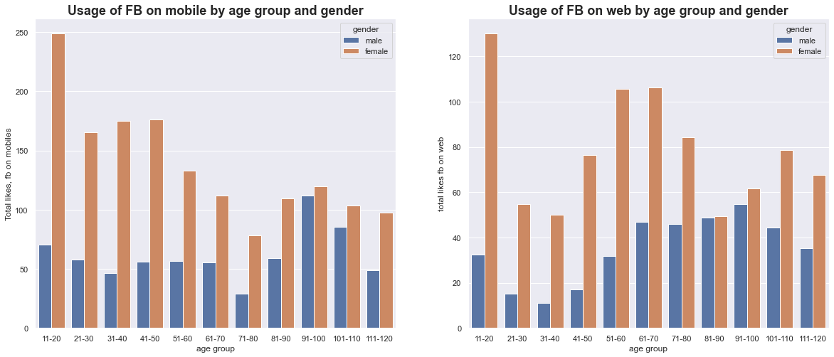
Platform usage by Gender and age wise
Based on these graphs we can say that Facebook is mostly used on mobiles. With growing tech era use of mobile phones has become quite necessary and people are using it more to stay connected hence the company should focus on enhancing mobile app to have more user base.
Also advertisement can be introduces on mobile app which will add income to advertisers
Another point to note here is that males have less count of likes up to age 80 and then we see sharp increase for age 91-100. The unusual way could be because Facebook has default birth date as 1 Jan 1990. It may be the case when user just skip over detail, or keep maintaining their privacy. Whatever the case, it’s important to look over these anomaly and understand the impact.

Slide 20
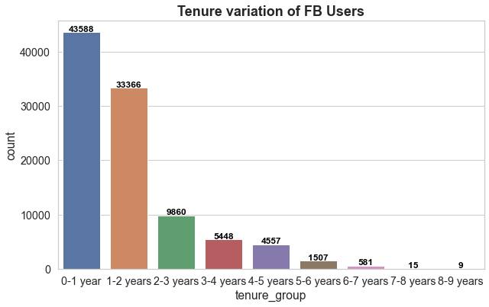

Year wise evaluation of FB
Highest tenure for usage of Facebook is 1 year and avg is 1.5 years.
This helps in defining the model to engage users for more than a year
We see a sharp increase in user base in last 2 years (~365.68%).
Since our data set is of 2013 it shows more people joined from 2009 onwards and that possibly could be because of
mobile app as facebook app was launched in 2008.

Slide 21
In Glance
Gender: With 59.3% of males, they are using Facebook more . Hence Facebook should focus on promoting activities which will increase female user base and at the same time continue working on male activities to keep the count intact
Friends: Youngster have wider friend circle . Additionally though male users are more and they initiate more friend requests yet females have more friends. Youngster can get more user base by inviting their friends on facebook. Hence marketing team can come up with attractive strategies here
Age Group: Young population in age group 10-30 years is heavy user of Facebook. Hence marketing insight should focus on youngster as they have time and interest.
Spurious Users: With 4.95% of users entering their incorrect details, raise concerns on genuine accounts on Facebook. Hence developers should comeup with strict checks to avoid misleading information such as age.
Likes: Females tend to get more likes than their male counterparts, ~2.5 times more. Likes can be very helpful in promoting small or large scale business by introducing advertisements.
Tenure: We see a huge % increase (~ 365.6% ) in Facebook users between 2009 and 2013. Facebook mobile app was launched in 2008 and hence we see this huge spike in active users in following years. Marketing team should work to enhance tenure longevity by introducing new features.

Slide 22


